Slide 1
SOC476A PROJECT PRESENTATION
DEMOGRAPHIC TRANSITION OF SINGAPORE

Slide 2
Singapore’s demographic transition over the years- A Brief Overview
-> Singapore's population has changed a lot over time.
-> After World War II, there were high birth rates and high death rates.
-> Presently, both the birth rates and death rates have become low.
->This change happened as Singapore grew quickly in the last 50 years.
->It has become a rich and developing society.

Slide 3
Singapore’s population over the years
-> Singapore had a population of 1 million in 1950.
-> It has seen significant growth in its resident population, including citizens and permanent migrants.
-> Its population has reached 6.04 million as of March 2024.

Slide 4
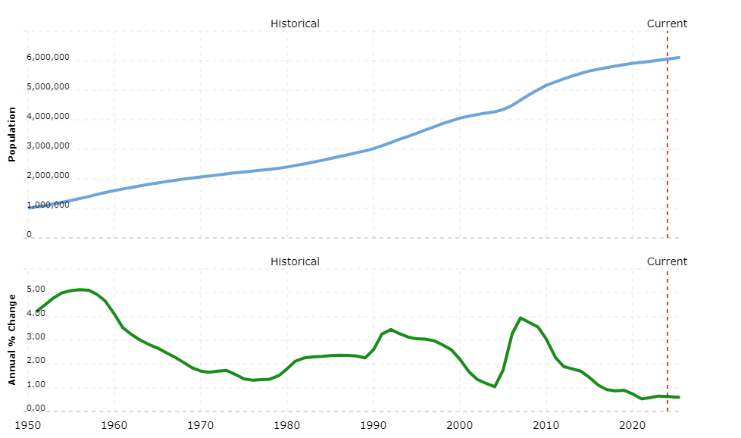
Singapore’s Population over the years

Slide 5
Singapore’s Phases of Demographic Transition
-> Singapore's demographic evolution can be seen to begin from the late 1940s.
-> It can be divided into four distinct phases.
-> Each phase has been marked by specific population trends and socioeconomic changes.
-> The fourth phase is currently taking shape.

Slide 6
First Stage of Demographic Transition
-> From late 1940s to mid 1960s
-> Population Boomed
-> Increased Birth rates
-> High death rates

Slide 7
1.(a) Population Boom
-> After the conclusion of World War II in 1945, Singapore's population growth was deemed unsustainable for its economic outlook.
-> Between 1947 and 1964, approximately 1 million individuals were born, resulting in a 58% increase in total live births.
-> Throughout this timeframe, the average annual growth rate stood at 4.4%, with immigration accounting for 1% of this growth.

Slide 8
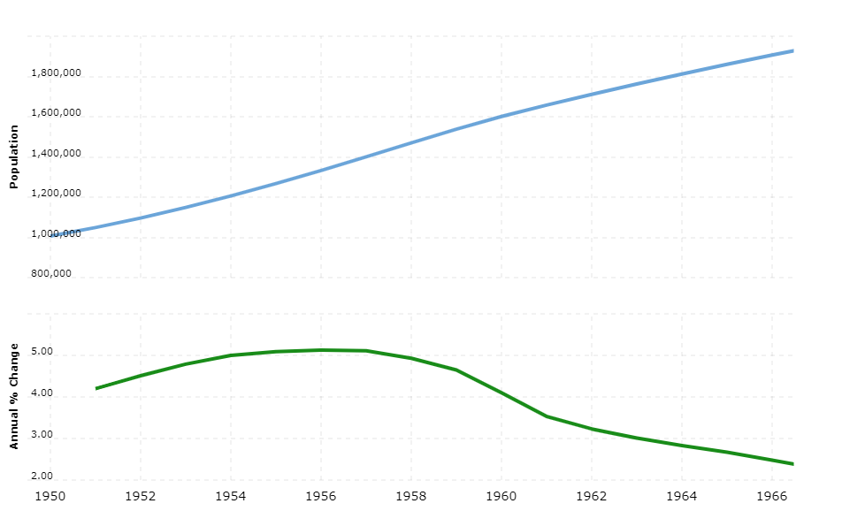
1.(a) Population Boom

Slide 9
1.(b) Increased birth rates
–> In 1957, Singapore recorded its peak birth rate at 42.7 per thousand individuals.
–> Concerns about overpopulation, such as resource scarcity, environmental damage, rising unemployment, and higher living costs, prompted the government to take measures to control population growth.

Slide 10
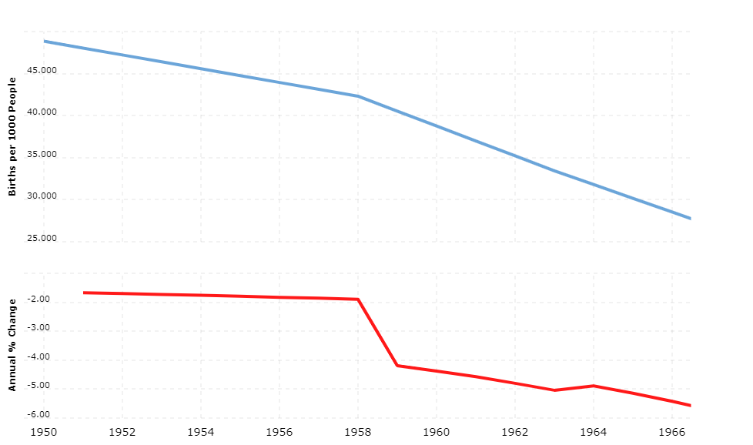
1.(b) Increased birth rates

Slide 11
1.(c) High death rates
-> During this phase, along with birth rates, death rates were also high.
-> Medical facilities in Singapore were not quite good and less awareness among the masses.
-> This lead to increasing number of deaths thus leading to a high death rate.

Slide 12
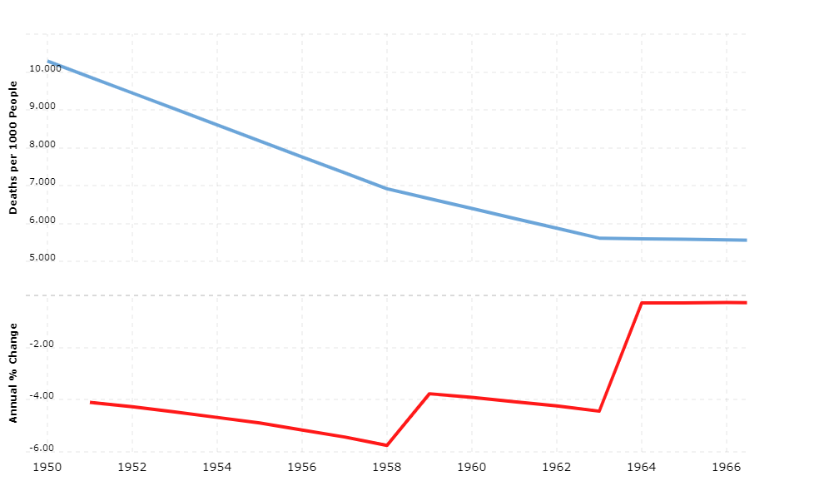
1.(c) High death rates

Slide 13
2.) Second Stage of Demographic Transition
-> From early 1970s to mid 1980s
-> Population increased
-> Death Rate decreased
-> High fertility

Slide 14
2.(a) Population increased
→ Singapore witnessed a gradual decline in the CBR(Crude Birth Rate) during the second phase.
→ The Crude Death Rate (CDR) remained low, approximately at 5 per 1,000 population.
-> Life expectancy continued to rise, and infant mortality rates declined.
→ Throughout this period, Singapore's population growth remained stable, ranging from 1.3% to 1.9% per annum.

Slide 15
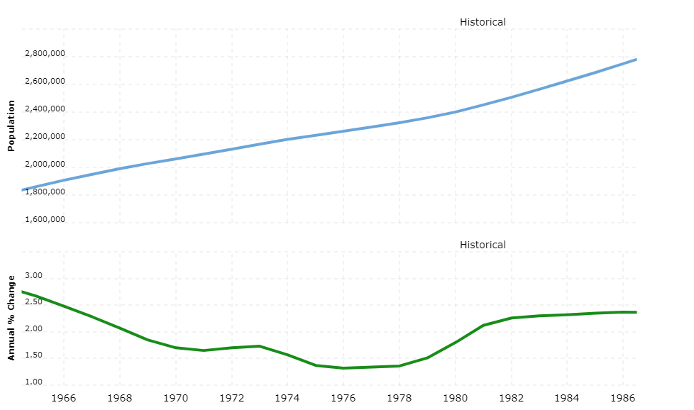
2.(a) Population increased

Slide 16
2(b). Decreased death rates
→ 2(b). (i) Modern contraceptive methods :-
-> Modern contraceptive methods had a large impact in managing Singapore’s population during this phase.
-> Despite declining fertility rates, family planning services were introduced, and measures were taken to reduce the rate of population growth.
-> These policies were aimed at managing population growth to a level that Singapore's infrastructure, education, and job market could support.
-> The availability of modern contraceptive methods facilitated rational fertility control.

Slide 17
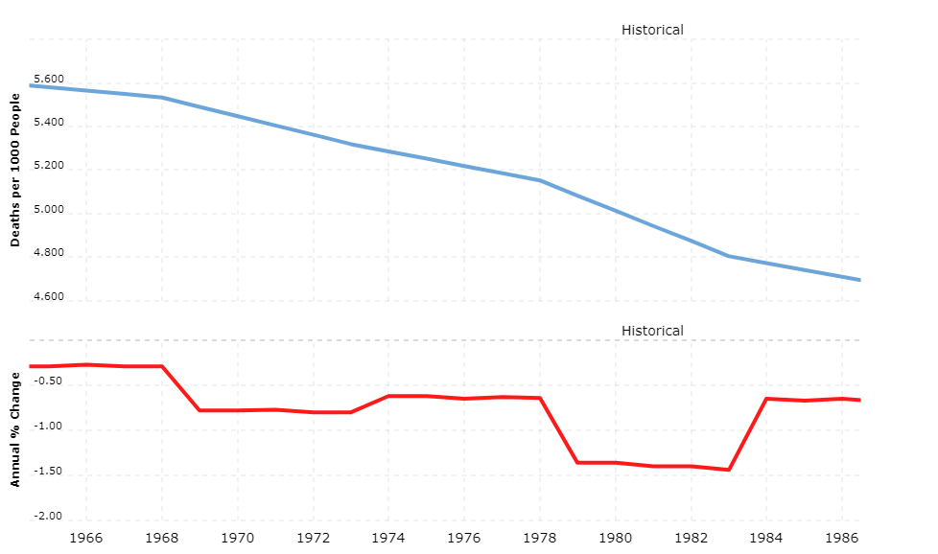
2(b). Decreased death rates

Slide 18
2(c). Fertility increased
2(c) .(i) -> “Stop-at-Two” Policy:-
-> In the late 1960s, Singapore was classified as a developing nation and had yet to undergo the demographic transition.
-> Although birth rates had declined from 1957 to 1970, they rose again in 1970 as women who were themselves products of the post-war baby boom reached maturity.
-> Concerned that the growing population might strain the developing economy, an active family planning campaign “Stop at Two” was initiated.

Slide 19
2(c). Fertility increased
2(c) .(i) -> “Stop-at-Two” Policy:-
-> Abortion and sterilization were legalized in 1970, and women were encouraged to undergo sterilization after their second child.
-> Additionally, the government implemented a series of incentives and disincentives between 1968 and 1973.

Slide 20
2(c). Fertility increased
2(c) .(i) -> “Stop-at-Two” Policy:-
-> Parents were penalized for having more than two children, and the per-child costs of each additional child increased gradually:
- In 1968, under the Employment Bill, female employees were not entitled to maternity leave for their fourth child or any subsequent children.
- In April 1969, the accouchement fee charged at Government Maternity Hospitals increased from $10 to $50 after the third baby.

Slide 21
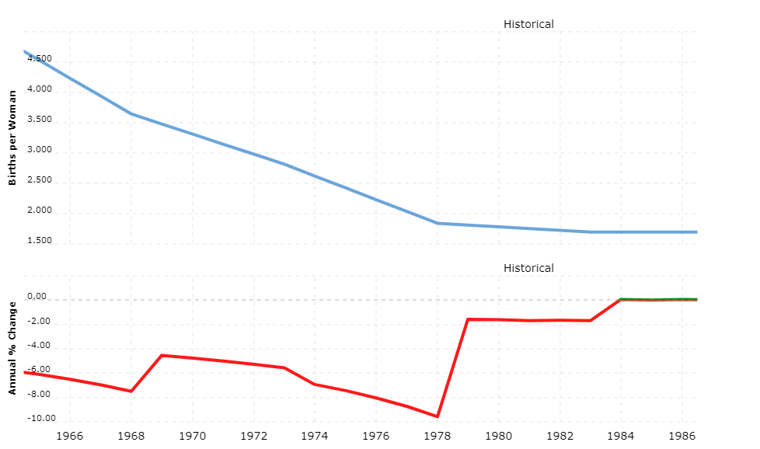
2(c). Fertility increased

Slide 22
3.) Third Stage of Demographic Transition
-> From mid 1980s to late 2000s
-> Population stabilized
-> Birth Rate Decreased

Slide 23
3.(a) Population Stabilized
–> In 1986, as fertility rates reached a historically low point of 1.4, the Singaporean government made a significant decision to completely reverse its two-child policy.
-> It marked the start of a new phase in the country's demographic trajectory.
-> The government aimed to raise public awareness about the sustained sub-replacement fertility levels observed since 1975.
->During the late 1980s, a campaign with the slogan "Have Three or More (if You Can Afford It)" was launched to encourage larger families.
-> By then, Singapore had been experiencing sub-replacement fertility levels for over a decade.

Slide 24
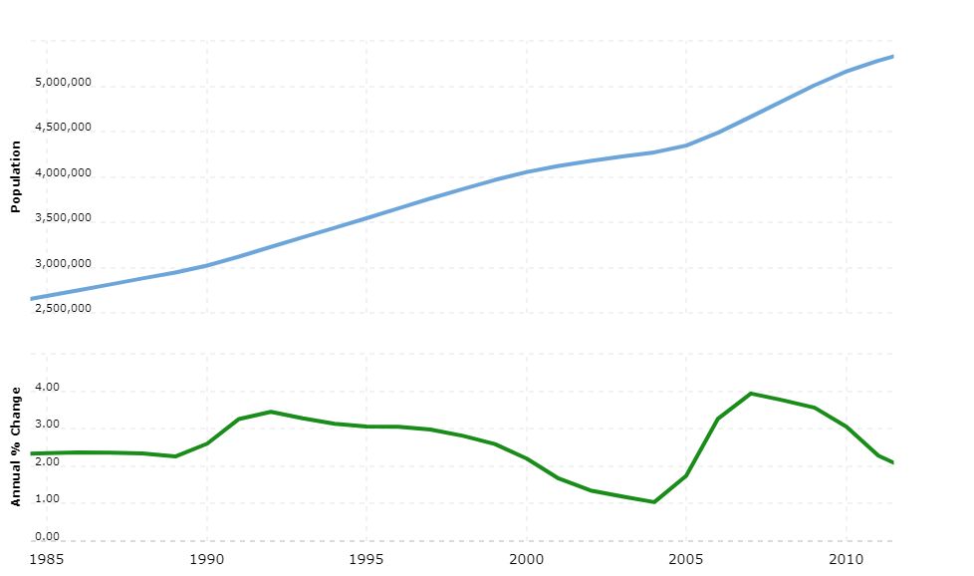
3.(a) Population Stabilized

Slide 25
3.(b) Birth Rate Decreased
3.(b).(i) Pro-natalist measures:-
-> Pro-natalist measures were introduced in 1987.
-> They were implemented to address the decline in fertility rates and encourage higher birth rates in Singapore.
-> These measures involved widespread public campaigns promoting marriage and parenthood.

Slide 26
3.(b) Birth Rate Decreased
3.(b).(i) Pro-natalist measures:-
-> They were spread along with slogans like "Have Three or More (if you can afford it)," aiming to reshape societal attitudes towards family planning.
-> To further support families, incentives such as tax rebates, parental leave, and childcare subsidies were provided.
-> These incentives were aimed to alleviate the financial burden of raising children and encourage couples to consider expanding their families.

Slide 27
3.(b) Birth Rate Decreased
3.(b).(ii) “Have-Three-or-More (if you can afford it)”
Policy
-> This change in policy was prompted by Singapore's decreasing fertility rate and the increasing proportion of elderly citizens.
-> However, it also aimed to address concerns about the unequal distribution of births between the educated and uneducated segments of society.
-> Couples with insufficient income were advised against having more than two children to minimize the welfare aid spent on such families.

Slide 28
3.(b) Birth Rate Decreased
3.(b).(ii) “Have-Three-or-More (if you can afford it)”
Policy
-> Additionally, the government relaxed its immigration policies during this time.
-> In 1986, the Singaporean government acknowledged the serious issue of declining birth rates.
-> They made a significant shift away from its previous "Stop-at-Two" policy.

Slide 29
3.(b) Birth Rate Decreased
3.(b).(ii) “Have-Three-or-More (if you can afford it)”
Policy
-> Instead, it began promoting higher birth rates.
-> By June 30 of that year, the Family Planning and Population Board was dissolved, and by 1987, the total fertility rate had dropped to 1.44.
-> During this period, a new slogan was introduced: "Have Three or More (if you can afford it)," advocating for larger family sizes of three or more children for financially stable married couples, while emphasizing the joys of family life.

Slide 30
3.(b) Birth Rate Decreased
3.(b).(iii) “Baby Bonus” Scheme :-
-> The Baby Bonus Scheme served to alleviate the financial challenges associated with raising children and incentivize parents to consider having more children.
-> It was initially implemented on April 1, 2001. It was subsequently strengthened on August 1, 2004.
-> Further enhancements were made on August 17, 2008, extending increased benefits to Singaporean citizens, including the first and second child benefits, even beyond the fourth child.

Slide 31
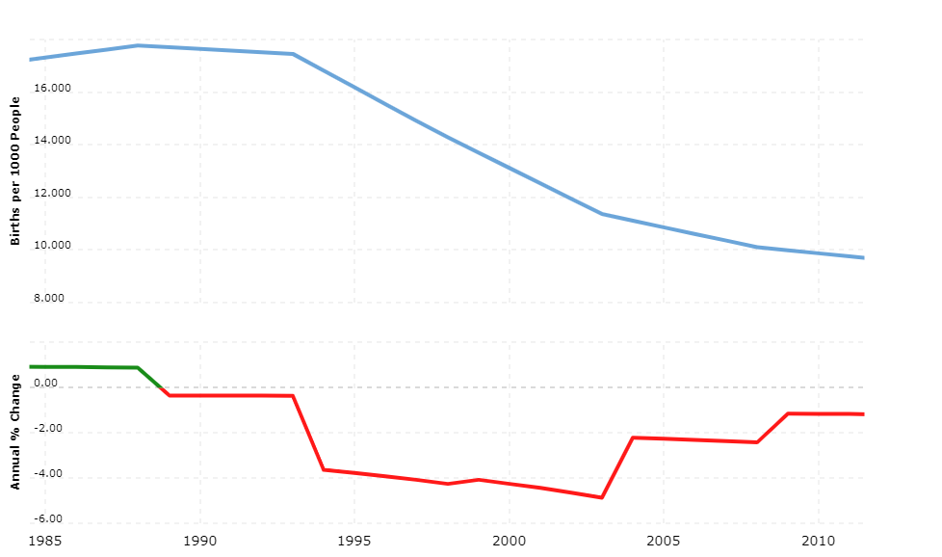
3.(b) Birth Rate Decreased

Slide 32
4.) Fourth Stage of Demographic Transition
-> From late 2000s - Ongoing
-> Population growing slowly
-> Decreasing Birth rates
-> Death rates stabilizing

Slide 33
4.(a) Population growing slowly
-> Singaporeans are enjoying longer lifespans, with the country boasting one of the highest life expectancies globally.
-> Given current birth rates and in the absence of immigration, projections indicate that Singapore's citizen population will decrease by around 2025.
-> A significant demographic milestone occurred in 2012 when the first cohort of post-war Baby Boomers, born between 1947 and 1965, began turning 65 years old.

Slide 34
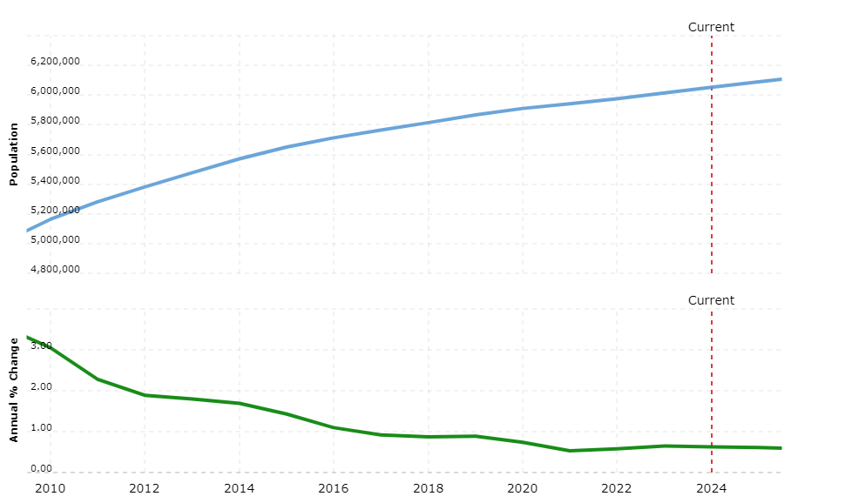
4.(a) Population growing slowly

Slide 35
4.(b) Decreasing birth rates
4.(b).(i) COVID-19 :-
-> The resident total fertility rate (TFR) in Singapore has recently fallen below 1, marking a historic low for the nation.
-> The estimated resident TFR for 2023 stands at 0.97.
-> This ongoing decline in fertility rate coincides with Singapore's ageing population, presenting a significant dual demographic challenge.

Slide 36
4.(b) Decreasing birth rates
4.(b).(i) COVID-19 :-
-> Also, the TFR has further decreased from 1.04 in 2022 and 1.12 in 2021.
-> Several factors contribute to this decline, including disruptions caused by the Covid-19 pandemic to couples' marriage and family planning plans.
-> Also, the government is making efforts to support marriage and parenthood.

Slide 37
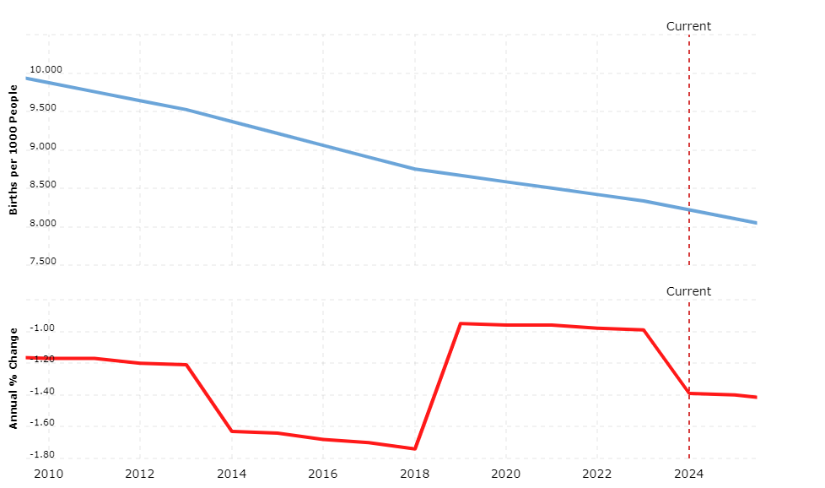
4.(b) Decreasing birth rates

Slide 38
4.(c) Death rates stabilizing
-> As of 2022, Singapore's population aged 65 and above has surged to 18.4%, representing an 11.1% increase from 2012.
-> This rapid ageing rate places Singapore among the nations experiencing the quickest demographic changes globally.
-> Singapore has now entered Stage 4 of the Demographic Transition Model, characterized by low birth rates and prolonged life expectancies, leading to a demographic shift towards an older population.

Slide 39
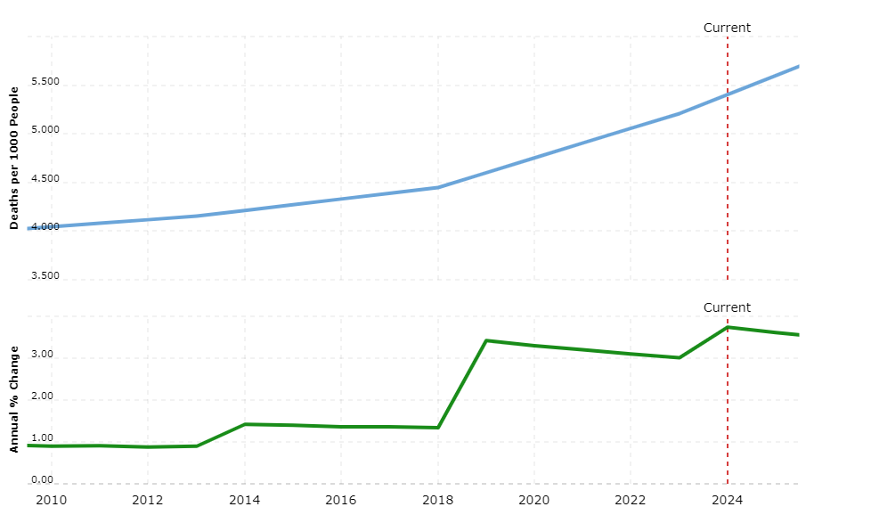
4.(c) Death rates stabilizing

Slide 40
Conclusion and Inference:-
-> Decline in fertility rates and the extension of life expectancy have substantial implications for various aspects of Singapore's citizen population, encompassing its size, the number of individuals within the working-age bracket, median age, and the ratio of support for the elderly.
-> Despite continuous efforts to promote marriage and parenthood, solely boosting the Total Fertility Rate (TFR) cannot fully counterbalance the challenges stemming from a shrinking and aging citizen populace, especially over the next few decades.

Slide 41
Conclusion and Inference:-
-> Immigration emerges as a potential strategy to alleviate the rate at which Singapore's citizen population ages and diminishes.
-> By embracing immigrants, Singapore can inject vitality into its citizen population and effectively address demographic concerns.

Slide 42
THANK YOU !

